Slide 1
Introduction to C
C programming language was developed in 1972 by Dennis Ritchie at bell laboratories of AT&T (American Telephone & Telegraph), located in the U.S.A..
It was initially designed for programming in UNIX operating system.
Now the software tool as well as the C compiler is written in C. Major parts of popular operating systems like Windows, UNIX, Linux is still written in C.

Slide 2
Characteristic of C Programming Language
C is a General Purpose Programming Language. This means C can be used to write a variety of applications. It is often referred to as a “system programming language.”
C is a middle level language, which means it combines the features of high level language with the functionality of an assembly language.
C is a structured programming language, which means as a programmer, you are required to divide a problem into a several different modules or functions.
C is portable, which means a C program runs in different environments. C compilers are available for all operating systems and hardware platforms. Additionally, you can easily write code on one system and port it to another.
C is super fast. The compilation and execution of programs is much faster on C than with most other languages.
C is easy to debug. The C compiler detects syntax errors quickly and easily and displays the errors along with the line numbers of the code and the error message.
Finally, C has a rich set of library functions and supports graphic programming too.

Slide 3
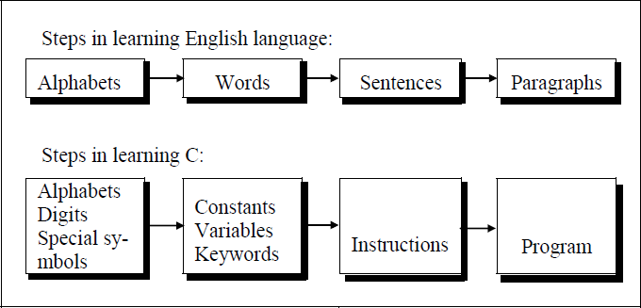
Program
The classical method of learning English is to first learn the alphabets used in the language, then learn to combine these alphabets to form words, which in turn are combined to form sentences and sentences are combined to form paragraphs.
Learning C is similar and easier. How to write program we must first know what alphabets, numbers and special symbols are used in C, then how using them constants, variables and keywords are constructed, and finally how are these combined to form an instruction. A group of instructions would be combined later on to form a program. So

Slide 4
Programming Language- two types
Low level language
High level language
Low level language: Low level languages are machine level and assembly level language. In machine level language computer only understand digital numbers i.e. in the form of 0 and 1. So, instruction given to the computer is in the form binary digit, which is difficult to implement instruction in binary code. This type of program is not portable, difficult to maintain and also error prone
assembly language :is on other hand modified version of machine level language. Where instructions are given in English like word as ADD, SUM, MOV etc. It is easy to write and understand but not understand by the machine. So the translator used here is assembler to translate into machine level. Although language is bit easier, programmer has to know low level details related to low level language. In the assembly level language the data are stored in the computer register, which varies for different computer. Hence it is not portable.
High level language: These languages are machine independent, means it is portable. The language in this category is Pascal, Cobol, Fortran etc. High level languages are understood by the machine. So it need to translate by the translator into machine level. A translator is software which is used to translate high level language as well as low level language in to machine level language.

Slide 5
Compiler and Interpreter
Compiler and interpreter are used to convert the high level language into machine level language. The program written in high level language is known as source program and the corresponding machine level language program is called as object program. Both compiler and interpreter perform the same task but there working is different.
Compiler read the program at-a-time and searches the error and lists them. If the program is error free then it is converted into object program. When program size is large then compiler is preferred.
Whereas interpreter read only one line of the source code and convert it to object code. If it check error, statement by statement and hence of take more time.
Source Program Object program
(High level language program) (Machine level language program)

Slide 6
Comment and Preprocessor Directive
C Comments
It indicates the purpose of the program. It is represented as
/*……………………………..*/ Comment line is used for increasing the readability of the program. It is useful in explaining the program and generally used for documentation. It is enclosed within the decimeters. Comment line can be single or multiple line but should not be nested. It can be anywhere in the program except inside string constant & character constant.
Preprocessor Directive:
#include<stdio.h> tells the compiler to include information about the standard input/output library. It is also used in symbolic constant such as #define PI 3.14(value). The stdio.h (standard input output header file) contains definition &declaration of system defined function such as printf(), scanf( ), pow( ) etc. Generally printf() function used to display and scanf() function used to read value.

Slide 7
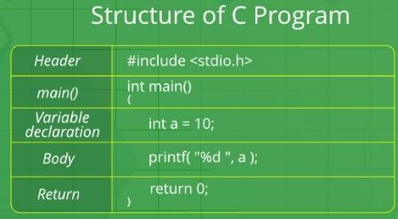
Structure of C Program

Slide 8
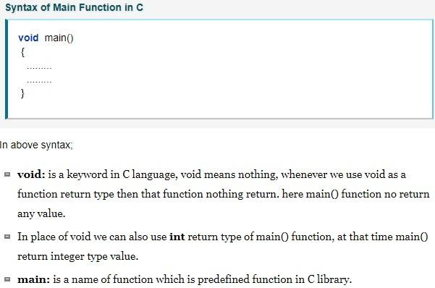

Slide 9
/*First c program with return statement*/
#include <stdio.h>
int main ()
{
printf ("welcome to c Programming language.\n"); return 0;
}
Output: welcome to c programming language.

Slide 10
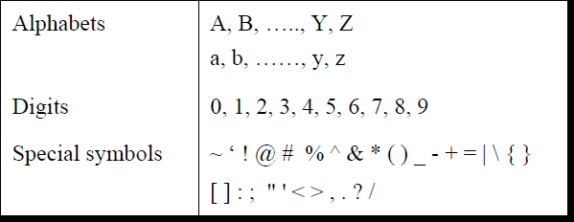
Character Set
A character denotes any alphabet, digit or special symbol used to represent information. Valid alphabets, numbers and special symbols allowed in C are
The alphabets, numbers and special symbols when properly combined form constants, variables and keywords.

Slide 11
Identifiers
Identifiers are user defined word used to name of entities like variables, arrays, functions, structures etc.
Rules for naming identifiers are:
(How we declare the variable)
1. name should only consists of alphabets (both upper and lower case), digits and underscore (_) sign.
2. first characters should be alphabet or underscore
3. should not be a keyword
4. since C is a case sensitive, the upper case and lower case considered differently, for example code, Code, CODE etc. are different identifiers.
6. No commas or blanks are allowed with in a variable name. No special symbol other than underscore
7. identifiers are generally given in some meaningful name such as value, net_salary, age, data etc. An identifier name may be long, some implementation recognizes only first eight characters, most recognize 31 characters. ANSI standard compiler recognize 31 characters.
invalid identifiers - 5cb, int, res#, avg no etc.

Slide 12
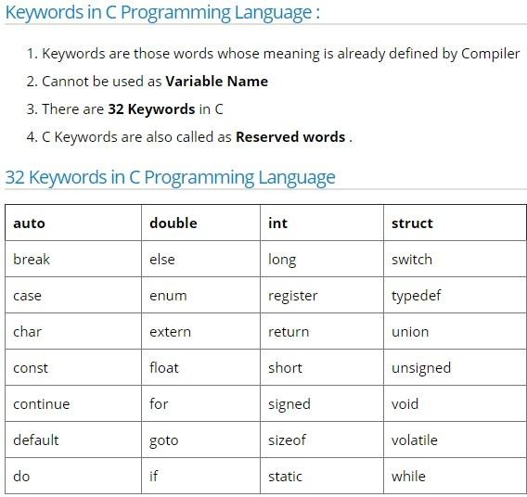
C Keywords

Slide 13
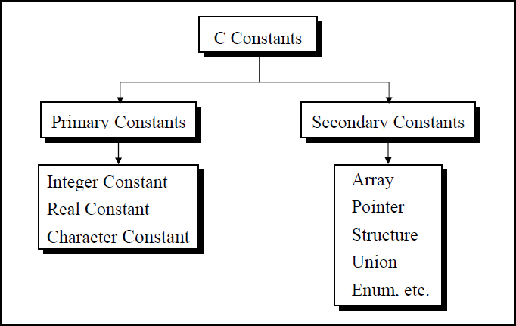
Constant
Constant is any value that cannot be changed during program execution. In C, any number, single character, or character string is known as a constant.
A constant is an entity that doesn’t change whereas a variable is an entity that may change. For example, the number 50 represents a constant integer value. The character string "Programming in C is fun.\n" is an example of a constant character string. C constants can be divided into two major categories:
Primary Constants
Secondary Constants
These constants are further categorized as

Slide 14
Numeric constant: Numeric constant consists of digits. It required minimum size of 2 bytes and max 4 bytes. It may be positive or negative but by default sign is always positive.
No comma or space is allowed within the numeric constant and
it must have at least 1 digit.
The allowable range for integer constants is -32768 to 32767. Truly speaking the range of an Integer constant depends upon the compiler. For a 16-bit compiler like Turbo C or Turbo C++ the range is –32768 to 32767.
For a 32-bit compiler the range would be even greater.
It is categorized a integer constant and real constant. An integer constants are whole number which have no decimal point. Types of integer constants are:
Decimal constant: 0 9(base 10)
Octal constant: 0 7(base 8)
Hexa decimal constant: 0----9, A-------F(base 16)
In decimal constant first digit should not be zero unlike octal constant first digit must be zero(as 076, 0127)
In hexadecimal constant first two digit should be 0x/ 0X (such as 0x24, 0x87A). By default type of integer constant is integer but if the value of integer constant is exceeds range then value represented by integer type is taken to be unsigned integer or long integer. It can also be explicitly mention integer and unsigned integer type by suffix l/L and u/U.

Slide 15
Real constant ( also called floating point constant)
To construct real constant we must follow the rule of ,
real constant must have at least one digit.
It must have a decimal point.
It could be either positive or negative.
Default sign is positive.
No commas or blanks are allowed within a real constant. Ex.: +325.34 , 426.0, -32.76
To express small/large real constant exponent(scientific) form is used where number is written in mantissa and exponent form separated by e/E. Exponent can be positive or negative integer but mantissa can be real/integer type,
Example 3.6*10⁵=3.6e+5.
By default type of floating point constant is double, it can also be explicitly defined it by suffix of f/F.

Slide 16
Character Constant
Character constant represented as a single character enclosed within a single quote.
These can be single digit, single special symbol or white spaces such as ‘9’,’c’,’$’, ‘ ’ etc.
A Z ASCII value (65-90)
a z ASCII value (97-122)
0-------------9 ASCII value (48-59)
; ASCII value (59)
String Constant
Set of characters are called string and when sequence of characters are enclosed within a double quote (it may be combination of all kind of symbols) is a string constant.
String constant has zero, one or more than one character and at the end of the string null character(\0) is automatically placed by compiler.
examples - “sarathina” , “908”, “3”, ” ”, “A” etc.
Note-
In C although same characters are enclosed within single and double quotes it represents different meaning such as “A” and ‘A’ are different because first one is string attached with null character at the end but second one is character constant with its corresponding ASCII value is 65.

Slide 17
Symbolic constant
Symbolic constant is a name that substitute for a sequence of characters and, characters may be numeric, character or string constant. These constant are generally defined at the beginning of the program as
#define name value , here name generally written in
upper case for example
#define MAX 10
#define CH ‘b’
#define NAME “sony”

